Slide 1


Hospital Management System in C Language
Discover how to build a robust Hospital Management System using C language, including functionalities like patient admission, record management, and more.

Slide 2
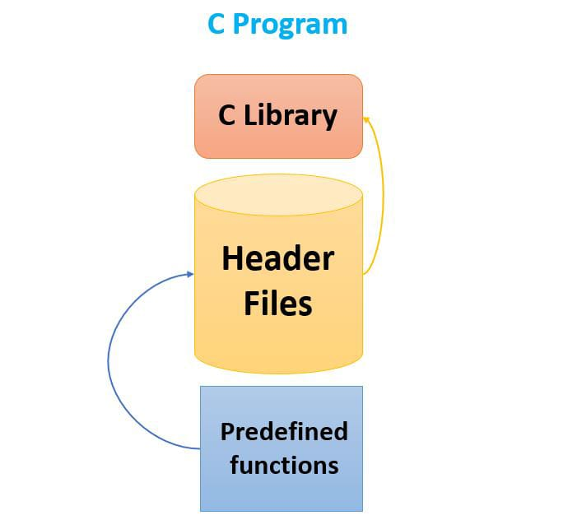
Header Files
Standard C Libraries
Includes stdio.h, string.h, unistd.h, and stdlib.h.
Main Function
1
Program Execution
Calls Login, title, and home_page functions to initiate program execution.

Slide 3

Function Prototypes
1
search_record
Retrieve patient details by first name.
2
Login
Authenticate users with username and password.
3
Admit_patient
Add patient records, search and delete records.
Title Function
1
Welcome Message
Displays a warm welcome and the Hospital Management System title.

Slide 4

Login Function
1
User Authentication
Requests username and password, allowing three attempts for login.
Home Page Function
1
Functionalities Menu
Provides options for patient admission, record management, adding & removing doctors, and more.

Slide 5

Search Record Function
1
Search Patient Details
Enables searching for patient records based on first name.
Delete Data Function
1
Discharge Patient
Prompts for first and last name, removes corresponding record from patient file.

Slide 6
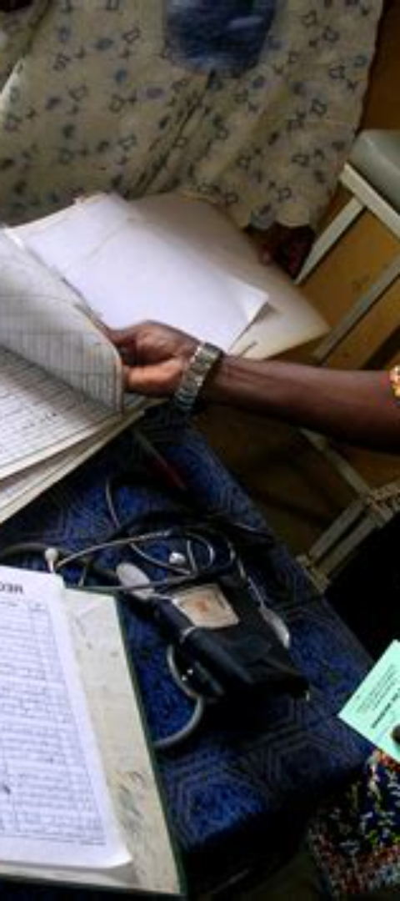
Admit Patient Function
1
Patient Record Management
Options for adding, searching, deleting patient records, and returning to home page.
Patient List Function
1
Display Admitted Patients
Shows a list of currently admitted patients.
Patient Record Function
1
Add New Patient
Allows input of details for a new patient, which will be added to the patient file.

Slide 7

Remove Doctor Function
1
Remove Doctor Information
By providing first and last name, removes the corresponding doctor's record from the file.
Doctor Record Function
1
Add New Doctor
Enables input of details for a new doctor, which will be added to the doctor file.
Display Doctor Record Function
1
View Doctors List
Displays a list of doctors along with their details.

Slide 8
PSEUDO-CODE
search_record:
Ask the user if they want to search.
If yes, ask for the first name of the patient.
Open the patient file and read it.
While reading the file, if the first name matches with the user input, display the record.
If the user enters E, exit the function and go back to Admit_patient function
2.delete_data:
Open the patient file in read mode and a temporary file in write mode.
Ask the user which patient record they want to delete.
While reading the patient file, if the name matches with the user input, don't write it into the temporary file (this effectively deletes the record).
If the record is found, print a success message, otherwise print a record not found message.
Close both files, remove the original patient file and rename the temporary file as the patient file.
If the user enters 'E', go back to the home page.
Admit_patient:
Display the options: Add Patient Record, Search Patient Record, Delete Patient Record, and Exit.
Based on the user's choice, call the respective function.
If the user's choice is invalid, print an error message.
Patient_List:
Open the patient file in read mode.
Read and print all the records in the file.
If the user enters 'E', go back to the home page.
Patient_record:
Open the patient file in append mode.
Ask the user for the patient's details: name, age, gender, disease, and contact number.
Write these details into the file.
If the user enters 'E', go back to the home page.
Remove_doctor:
Open the doctor file in read mode and a temporary file in write mode.
Ask the user which doctor they want to remove.

Slide 9
While reading the doctor file, if the name matches with the user input, don't write it into the temporary file (this effectively removes the doctor).
If the record is found, print a success message, otherwise print a record not found message.
Close both files, remove the original doctor file and rename the temporary file as the doctor file.
If the user enters 'E', go back to the home page.
Doctor_record:
Open the doctor file in append mode.
Ask the user for the doctor's details: name, specialization, experience, graduation, and assistant number.
Write these details into the file.
If the user enters 'E', go back to the home page.
display_doctor_record:
Open the doctor file in read mode.
Read and print all the records in the file.
If the user enters 'E', go back to the home page.
home_page:
Display the options: Admit Patient, Patient List, Discharge Patient, Add Doctor, Doctor List, Remove Doctor, and Exit.
Based on the user's choice, call the respective function.
If the user's choice is invalid, print an error message.
Login:
Ask the user for username and password.
If they match the predefined username and password, print a success message and proceed to the next function.
If they don't match, decrease the number of tries left and ask again.
If the number of tries reaches 0, exit the program.
title:
Print the title of the program.
main:
Call the Login function.
Call the title function.
Call the home_page function.

Slide 11

Thank You!
Thank you for your attention and participation in this presentation. We hope you found the information helpful and insightful. If you have any further questions or would like to learn more, please don't hesitate to reach out to us. We appreciate your time and interest!

